Slide 2
Paper summary: Key insights
Utilises detailed administrative microdata to understand the characteristics of housing investors, and how these have changed over time.
Investors matter more than they used to (more of the population).
They own (slightly) more properties in a (slightly) more spread out set of regions.
Investors have higher taxable incomes.
The average investor has become older through time.
Negative gearing is popular, and its prevalence depends on underlying interest rates.
Housing investors are more highly leveraged – however, high DTI lending has declined significantly since 2022.
Debt increases with income while DTI declines.
These stylised facts are then used to describe financial stability risks in housing. Broad stability due to high income and low default risks, but areas where risk may be elevated:
Ageing population reliant on rental income.
Pockets of elevated leverage/high DTIs with low income that are vulnerable to shocks.

Slide 3
What questions do these insights inform?
The key focus of the piece is on documenting the status of housing investors, to understand financial stability risks. As part of this there is forthcoming work:
Simulating responses to adverse shocks.
Likely, more richly describing the joint distribution of factors.
What else do these insights inform us about?
Changes in the intergenerational share of wealth/income through housing (i.e. Varela, Breunig, and Smith [2025]; Siminski and Wilkins [2025]).
The magnitude of negative gearing, and the non-symmetric treatment of gains and expenses in the tax system (i.e. Dwyer and Garvin [2026], Gillitzer [2025]).
How binding are macroprudential regulation (i.e. February introduction of DTI limits for the majority of new residential mortgage lending).
Using the evidence in this way requires care.

Slide 4
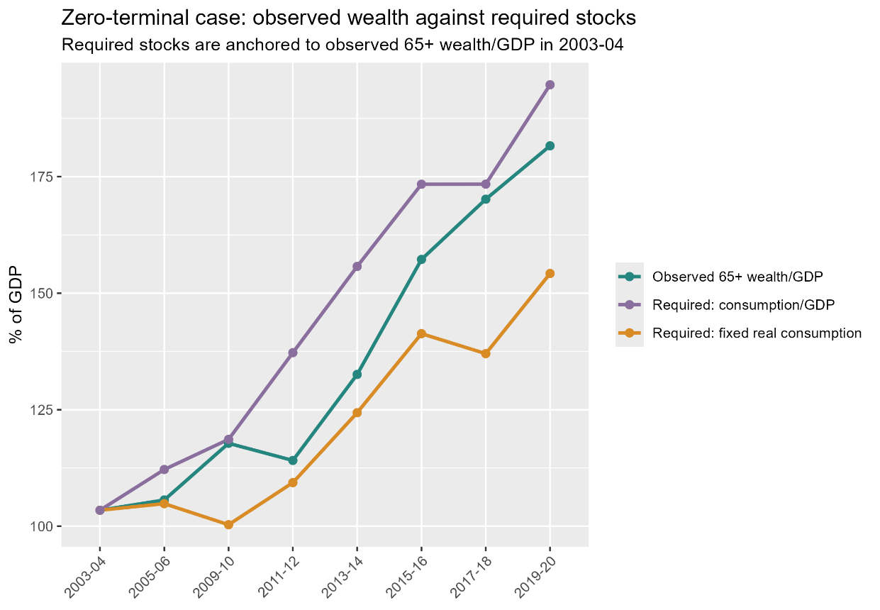
Intergenerational equity and housing investors
How many people are there?
How as life expectancy, interest rates, changed the “need” to save?

Slide 5
Insights for negative gearing debates
There are three detailed pieces discussing negative gearing today – so I will leave this mostly to the experts.
Negative gearing pattern driven by interest rates.
COVID level shift?
End-point of data near the “low” of outstanding fixed-rate loans.
Irrespective of behaviour, this suggests that any deferral of deduction bites more in a higher interest rate/inflation environment.
Key concerns are:
Inconsistent treatment of debt and equity financing.
Inconsistent taxation of different asset classes.

Slide 6
How do these insights relate to policy?
Combining various sources of administrative microdata provides a richer understanding of housing investors in Australia.
When combined with simulation/stress testing of households in the face of varying shocks, this heterogeneity helps the RBA, APRA, and other government agencies plan against future economic shocks.
However, using these insights to inform broader housing questions should be done with care.
Intergenerational equity is a nuanced topic, and many of the “simple statistics” the show one group benefiting largely reflect group size, longevity, and interest rate effects.
Negative gearing and tax reflects a concern about inconsistent treatment of debt and equity when it comes to asset allocation.

